Slide 1
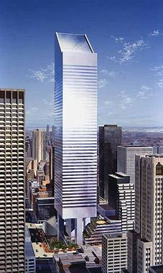
CITICORP CENTRE BUILDING CASE STUDY

Slide 2
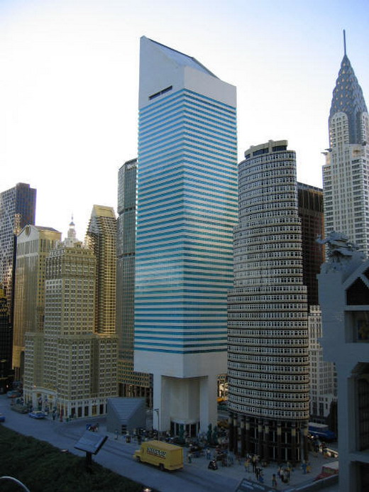
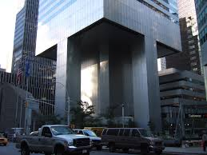
BACKGROUND
The Citicorp Center was completed in 1977, and is one of the most recognizable features of the New York City skyline.
The distinctive 45° angled top rises 915 feet into the air.
The base of the building, which is even more distinct, sits 114 feet in the air, supported by four giant columns centered, not on the building’s corners, but on each of its sides.
Hugh Stubbins was the Architect and William LeMessurier, the Structural Engineer

Slide 3
THE DESIGN
The building had a steel superstructure of 25,000 tons, which was lighter than those of similar skyscrapers
Due to the relatively light weight, building sway was a serious concern, and LeMessurier designed and installed a “tuned mass damper” in the angled top, the first of its kind implemented in the United States.
This was a 400-ton block of concrete, which floats on a film of oil, is computer controlled to absorb the energy of the swaying structure and to reduce the building’s wind-induced movement by as much as 50%.

Slide 4
THE DESIGN
Wind-loading was taken a being perpendicular to the face of the building, i.e. wind hitting one face of the building
Welded joints were provided for in the steel superstructure
The steel contractor proposed using bolted joints, which would still meet design requirements and would also be cheaper.
LeMessurier’s design team accepted this and the construction was changed to incorporate bolted joints instead of welding joints

Slide 5
A STUDENT’S INQUIRY
An university student using the Citicorp building for her under-graduate project, doing her own calculations found that quartering winds produced significantly higher stresses than those produced by winds hitting just one face of the building.
This structural behavior was different from a conventional building with columns placed at the four corners, where wind perpendicular to one face presents the worst loading case.
LeMessurier revisiting the original design, realized that the quartering wind effect was much more significant than earlier considered, with the bolted joints being inadequate, and given hurricane conditions, collapse of the building was a possibility

Slide 6
LeMessurier’s corrective action
Advised his architect, client’s lawyer and client’s insurance company
Advised Citicorp, the building owner
Advised the city authorities
Installed back-up generators for the tuned mass dampers
Retained a team of meteorological experts to determine the risk of damaging windstorms
Initiated a repair plan whereby the bolted diagonal splices would be reinforced with welded plates to increase their capacity
Developed an emergency evacuation plan for the area within a 5-block radius of the structure, involving 2000 Red Cross volunteer workers
Created a cover story to provide for the press, to explain the night-time welding operations in progress as an upgrade to reflect a recent change in the NYC building codes.

Slide 7
ETHICAL ISSUES
LeMessurier “whistle blew” on himself: he did not try to hide his error, but came out in the open and took the full responsibility for flawed design
The Code of Ethics for Engineers expects them to “Hold paramount the safety, health and welfare of the public”, and in taking necessary corrective action, the loss of life and injury to the public was avoided.
By paying attention to the comments of an undergraduate student, and having the humility to re-evaluate his design, LeMessurier ensured that the CitiCorp building was saved.
LeMessurier’s acts highlight the importance associated with constantly questioning and re-examining past decisions in light of new information or ideas. Design professionals must be open to other ideas, perspectives and criticisms while avoiding a “stubborn attachment to existing beliefs.”

Slide 8
ETHICAL ISSUES
Engineering Codes of Ethics, require that an engineer must “issue public statements only in an objective and truthful manner”. LeMessurier could have remained silent, but chose to be truthful about the error he made and objectively worked out and implemented the required corrective action
The Building Code of the City of New York did not call for analysis of so-called quartering winds. Like many other laws and regulations safeguarding public safety, building codes specify minimum standards and they do not necessarily reflect the state of the art or the prevailing standard of care.
Indeed, although during the early 1970s the New York Building Code made no mention of wind loads other than those produced by winds acting at right angles to building faces, many other tall structures in New York and elsewhere had been designed considering the effects of quartering winds. Until adoption of a new code in late 1968, New York had required that all structures be designed “to resist, in the structural frame, horizontal wind pressure from any direction.”
The distinguished engineer Matthys Levy, Executive Vice President and Director, Structural Division of the National Academy of Engineering and author of “Why Buildings Fall Down” observes,
“From the code point of view, it is implicit that wind from any direction should be considered, even if not stated explicitly.”

Slide 9
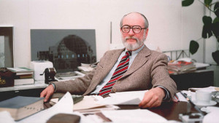
ETHICAL ISSUES
In the words of William LeMessurier to his students at Harvard:
“You have a social obligation. In return for getting a license and being regarded with respect, you’re supposed to be self-sacrificing and look beyond the interests of yourself and your client to society as a whole. And the most wonderful part of my story is that when I did it, nothing bad happened”

Slide 10
Acknowledgements:
..
Charles Harris, Michael Pritchard, Michael Rabins : Engineering Ethics – Concepts and Cases; Wadsworth Cengage Learning, 4th Edition
LeMessurier Stands Tall – A case study in Professional Ethics – Michael J. Vardaro: https://www.theaiatrust.com › whitepapers › ethics › study
LeMessurier and CityCorp Centre: ENGR/PHIL 482 Engineering & Ethics – CEProfs; https://ceprofs.civil.tamu.edu › rjames ›
The Citicorp Center Tower: how failure was averted – Sean Brady www.engineersjournal.ie › 2015/12/08 › citicorp-centre-tower-failure-averted
(RE)EXAMINING THE CITICORP CASE: Ethical Paragon or Chimera
- Eugene Kremer - http://crosscurrents.org/kremer2002.htm

